Slide 1
SQL PROJECT
Title: Sales Performance Analysis of Walmart Stores Using Advanced MySQL Techniques

Slide 2
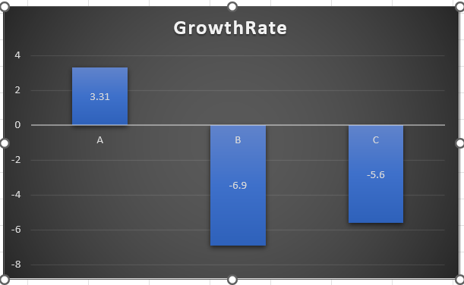
Identifying the Top Branch by Sales Growth Rate
With Monthly_revenue As (
Select Branch,
Month(str_to_date(date, '%d-%m-%y')) As Month_number,
Sum(total) As Total_rev
From walmartsales
Group By Branch, Month_number),
Growth_Rate As (
Select Branch, Month_number, Total_rev,
(Total_rev - Lag(total_rev) Over (Partition By Branch Order By Month_number))/Lag(total_rev)
Over (Partition By Branch Order By Month_number) * 100 As growth_rate
From Monthly_revenue)
Select Branch, Round(sum(total_rev),2) As Total_rev, round(sum(growth_rate),2) As Growth_rate
From Growth_Rate
Group By Branch;
Row Labels | GrowthRate
A | 3.31
B | -6.9
C | -5.6
Grand Total | -9.19
Monthly revenue is calculated by summing total sales for each branch on a monthly basis.
Growth rate is measured using previous month's sales difference with the current month.
Window functions like LAG() help identify sales patterns across months.
Branch A shows the highest growth rate (3.31%), indicating rapid business expansion.

Slide 3
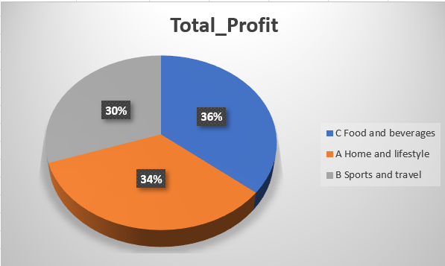
Finding the Most Profitable Product Line for Each Branch
WITH Profit_Calculation AS (
SELECT Branch,
`Product line`,
SUM(`gross income`) AS Total_Profit
FROM walmartsales
GROUP BY Branch, `Product line`
),
Rank_Profit AS (
SELECT Branch,
`Product line`,
Total_Profit,
RANK() OVER (PARTITION BY Branch ORDER BY Total_Profit DESC) AS RankValue
FROM Profit_Calculation
)
SELECT Branch,
`Product line` AS Most_Profitable_Product_Line,
Total_Profit
FROM Rank_Profit
WHERE RankValue = 1;
Branch | Most_Profitable_Product_Line | Total_Profit
C | Food and beverages | 1131.755
A | Home and lifestyle | 1067.4855
B | Sports and travel | 951.819
Here I used CTE to calculate the most Profitable Product Line for Each Branch, and also I used the Pie Chart to show the distribution of the Total_Profit.

Slide 4
Analyzing Customer Segmentation Based on Spending
with customer_spending as (
select `Customer ID`,sum(Total) as total_spent
from walmartsales
group by `Customer ID`
),
spending_category as
(
select `Customer ID`,total_spent,
case
when total_spent >(select avg(total_spent) from customer_spending) then 'HIGH'
when total_spent = (select avg(total_spent) from customer_spending) then 'MEDIUM'
else 'LOW'
end as Spending_Category
from customer_spending
)
select `Customer ID`,total_spent,spending_category
from Spending_Category;
Customer ID | total_spent | spending_category
2 | 23392.278 | HIGH
3 | 23402.2635 | HIGH
11 | 21398.8215 | LOW
9 | 19661.5965 | LOW
13 | 21063.6615 | LOW
1 | 22634.5455 | HIGH
8 | 26634.342 | HIGH
12 | 21720.6465 | HIGH
14 | 21049.4025 | LOW
5 | 19632.039 | LOW
10 | 20723.934 | LOW
6 | 20693.9565 | LOW
4 | 17656.716 | LOW
7 | 20628.09 | LOW
15 | 22674.456 | HIGH
Here I classified the Customers as HIGH, LOW, MEDIUM based on the total_amount spent. If the total_amount spent by them is greater than the average of total_spent then I classified the customers as HIGH, If total_spent is equal to the average of the total_spent then I classified them AS MEDIUM else I classified them as LOW

Slide 5
Detecting Anomalies in Sales Transactions
WITH Product_Avg AS (
SELECT `Product line`,
AVG(Total) AS Avg_Sales,
STDDEV(Total) AS Std_Sales
FROM walmartsales
GROUP BY `Product line`
),
Anomalies AS (
SELECT w.`Invoice ID`, w.`Product line`, w.Total,
CASE
WHEN w.Total > p.Avg_Sales + p.Std_Sales THEN 'High Anomaly'
WHEN w.Total < p.Avg_Sales - p.Std_Sales THEN 'Low Anomaly'
ELSE 'Normal'
END AS Anomaly_Type
FROM walmartsales w
JOIN Product_Avg p ON w.`Product line` = p.`Product line`
)
SELECT `Invoice ID`, `Product line`, Total, Anomaly_Type
FROM Anomalies
WHERE Anomaly_Type != 'Normal'
ORDER BY `Product line`, Total DESC;
Invoice ID | Product line | Total | Anomaly_Type
817-69-8206 | Electronic accessories | 942.4485 | High Anomaly
704-48-3927 | Electronic accessories | 931.035 | High Anomaly
267-62-7380 | Electronic accessories | 864.57 | High Anomaly
861-77-0145 | Electronic accessories | 860.685 | High Anomaly
638-60-7125 | Electronic accessories | 836.304 | High Anomaly
431-66-2305 | Electronic accessories | 833.9625 | High Anomaly
533-33-5337 | Electronic accessories | 833.595 | High Anomaly
457-94-0464 | Electronic accessories | 830.3715 | High Anomaly
227-07-4446 | Electronic accessories | 820.365 | High Anomaly
416-17-9926 | Electronic accessories | 779.31 | High Anomaly
884-80-6021 | Electronic accessories | 771.435 | High Anomaly
197-77-7132 | Electronic accessories | 769.104 | High Anomaly
525-09-8450 | Electronic accessories | 757.365 | High Anomaly
448-61-3783 | Electronic accessories | 756.168 | High Anomaly
155-45-3814 | Electronic accessories | 743.82 | High Anomaly
183-21-3799 | Electronic accessories | 733.6035 | High Anomaly
189-52-0236 | Electronic accessories | 731.6925 | High Anomaly
399-46-5918 | Electronic accessories | 722.232 | High Anomaly
831-81-6575 | Electronic accessories | 714.3255 | High Anomaly
850-41-9669 | Electronic accessories | 709.317 | High Anomaly
189-40-5216 | Electronic accessories | 708.3195 | High Anomaly
489-82-1237 | Electronic accessories | 690.018 | High Anomaly
538-22-0304 | Electronic accessories | 681.975 | High Anomaly
263-12-5321 | Electronic accessories | 680.61 | High Anomaly
868-06-0466 | Electronic accessories | 657.531 | High Anomaly
452-04-8808 | Electronic accessories | 640.038 | High Anomaly
672-51-8681 | Electronic accessories | 629.8425 | High Anomaly
699-14-3026 | Electronic accessories | 627.6165 | High Anomaly
137-63-5492 | Electronic accessories | 616.98 | High Anomaly
886-77-9084 | Electronic accessories | 603.876 | High Anomaly
660-29-7083 | Electronic accessories | 586.635 | High Anomaly
272-65-1806 | Electronic accessories | 575.316 | High Anomaly
466-61-5506 | Electronic accessories | 571.41 | High Anomaly
366-93-0948 | Electronic accessories | 69.6675 | Low Anomaly
Here Initially I calculated the Standard Deviation then I compared the Total with the Average Sales + Standard Deviation, If the Total is greater than the Average Sales + Standard Deviation then I classified it as High anomaly else I classified it as the Low anomaly.

Slide 6
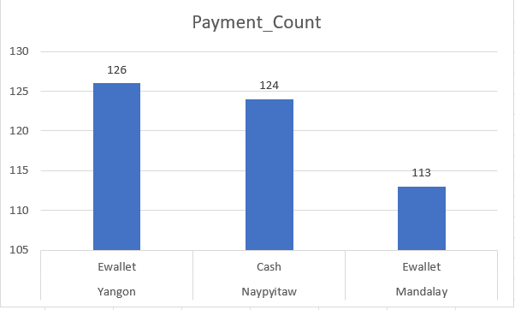
Most Popular Payment Method by City
with Payment_count as(
select City,Payment,Count(*) as Payment_count,
rank() over(partition by City order by count(*) desc ) as ran
from walmartsales
group by City,Payment
)
select City,Payment,Payment_Count
from payment_count
where ran=1;
City | Payment | Payment_Count
Yangon | Ewallet | 126
Naypyitaw | Cash | 124
Mandalay | Ewallet | 113
Payment_Count CTE:
It groups the data by City and Payment method.
Calculates the total number of transactions for each payment method using COUNT().
Assigns a rank to each payment method in the city using the RANK() function, ordering by the highest transaction count.
Final Selection:
Filters out only those payment methods where rank = 1, which represents the most frequently used payment method in each city.

Slide 7
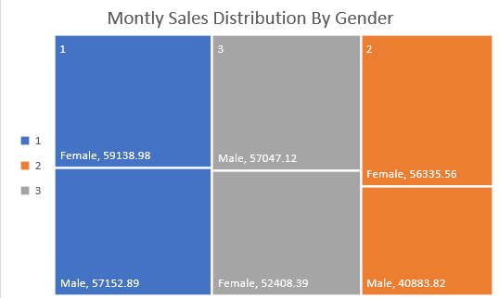
Monthly Sales Distribution by Gender
Month_Wise | Gender | total
1 | Female | 59138.98
1 | Male | 57152.89
2 | Female | 56335.56
2 | Male | 40883.82
3 | Female | 52408.39
3 | Male | 57047.12
with monthly_base as(
select sum(Total)as total,Gender, Month(str_to_date(Date,'%d-%m-%Y')) as Month_Wise
from walmartsales
group by Gender,Month_wise
)
select Month_Wise,Gender,round(total,2) as total
from monthly_base
order by Month_Wise,Gender;
It groups total sales by Gender and Month, rounding the sales amount to 2 decimal places to analyze monthly revenue distribution between male and female customers in an organized manner.

Slide 8
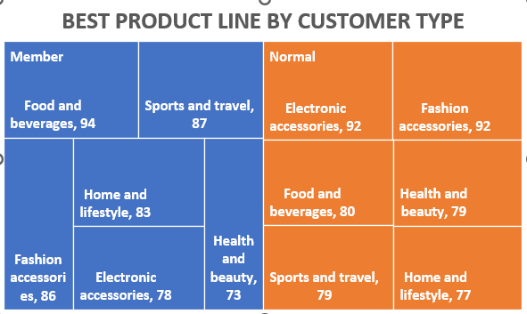
Best Product Line by Customer Type
SELECT `Customer type`, `Product line`, COUNT(`Product line`) AS Product_Count
FROM walmartsales
GROUP BY `Customer type`, `Product line`
ORDER BY `Customer type`, Product_Count DESC;
Customer type | Product line | Product_Count
Member | Food and beverages | 94
Member | Sports and travel | 87
Member | Fashion accessories | 86
Member | Home and lifestyle | 83
Member | Electronic accessories | 78
Member | Health and beauty | 73
Normal | Electronic accessories | 92
Normal | Fashion accessories | 92
Normal | Food and beverages | 80
Normal | Sports and travel | 79
Normal | Health and beauty | 79
Normal | Home and lifestyle | 77
Here I groups the Customers based on the Product_line there are two different customers ie, Normal and Member, Later I used a visual inorder to represent the data clearly.

Slide 9
Identifying Repeat Customers
Customer ID | Purchase_Date | Next_Purchase_Date | Days_Difference
1 | 05-01-2019 | 06-01-2019 | 1
1 | 06-01-2019 | 10-01-2019 | 4
1 | 10-01-2019 | 10-01-2019 | 0
1 | 10-01-2019 | 12-01-2019 | 2
1 | 12-01-2019 | 12-01-2019 | 0
1 | 12-01-2019 | 13-01-2019 | 1
1 | 13-01-2019 | 13-01-2019 | 0
1 | 13-01-2019 | 14-01-2019 | 1
1 | 14-01-2019 | 14-01-2019 | 0
1 | 14-01-2019 | 14-01-2019 | 0
1 | 14-01-2019 | 14-01-2019 | 0
1 | 14-01-2019 | 15-01-2019 | 1
1 | 15-01-2019 | 15-01-2019 | 0
1 | 15-01-2019 | 17-01-2019 | 2
1 | 17-01-2019 | 17-01-2019 | 0
1 | 17-01-2019 | 17-01-2019 | 0
1 | 17-01-2019 | 17-01-2019 | 0
1 | 17-01-2019 | 22-01-2019 | 5
1 | 22-01-2019 | 25-01-2019 | 3
1 | 25-01-2019 | 26-01-2019 | 1
1 | 26-01-2019 | 26-01-2019 | 0
1 | 26-01-2019 | 27-01-2019 | 1
1 | 27-01-2019 | 02-02-2019 | 6
1 | 02-02-2019 | 02-02-2019 | 0
1 | 02-02-2019 | 04-02-2019 | 2
1 | 04-02-2019 | 04-02-2019 | 0
WITH Repeat_Customers AS (
SELECT `Customer ID`,
`Invoice ID`,
str_to_date(Date, '%d-%m-%Y') AS Purchase_Date,
LEAD(str_to_date(Date, '%d-%m-%Y')) OVER (PARTITION BY `Customer ID` ORDER BY str_to_date(Date, '%d-%m-%Y')) AS Next_Purchase_Date
FROM walmartsales
),
Customer_Repeats AS (
SELECT `Customer ID`, Purchase_Date, Next_Purchase_Date,
DATEDIFF(Next_Purchase_Date, Purchase_Date) AS Days_Difference
FROM Repeat_Customers
WHERE Next_Purchase_Date IS NOT NULL
)
SELECT `Customer ID`, Purchase_Date, Next_Purchase_Date, Days_Difference
FROM Customer_Repeats
WHERE Days_Difference <= 30
ORDER BY `Customer ID`, Purchase_Date;
Here I Identified repeated customers who made multiple purchases within 30 days to understand customer retention patterns.
Applied LEAD() function to fetch the next purchase date and DATEDIFF() to calculate the time gap between consecutive purchases.

Slide 10
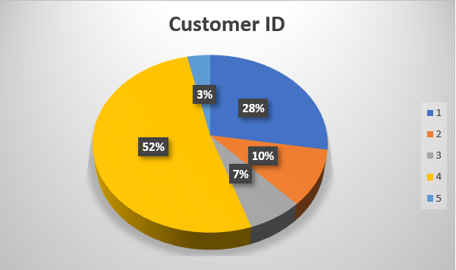
Finding Top 5 Customers by Sales Volume
SELECT `Customer ID`,
SUM(Total) AS total
FROM walmartsales
GROUP BY `Customer ID`
ORDER BY total DESC
LIMIT 5;
Customer ID | total
8 | 26634.342
3 | 23402.2635
2 | 23392.278
15 | 22674.456
1 | 22634.5455
Here I calculated the Top 5 Customers based on the Sales Volume and I used the pie chart to show the distribution of the top 5 customers based on the Sales Volume.

Slide 11
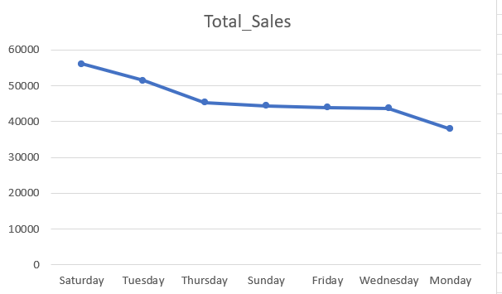
Analyzing Sales Trends by Day of the Week
Day_Name | Total_Sales
Saturday | 56120.81
Tuesday | 51482.25
Thursday | 45349.25
Sunday | 44457.89
Friday | 43926.34
Wednesday | 43731.14
Monday | 37899.08
SELECT DAYNAME(STR_TO_DATE(Date, '%d-%m-%Y')) AS Day_Name,
round(SUM(Total),2) AS Total_Sales
FROM walmartsales
GROUP BY Day_Name
ORDER BY Total_Sales DESC
LIMIT 1;
Here I calculated the Total_Sales Trends By day of the Week and inorder to show the sales visually i used the line chart

